Slide 1

AMSAT
FOX+
ENGINEERING
FOX+
Project Update
October 25, 2024
Mike Moore, K4MVM
Notes:
FOR OFFICAL USE ONLY

Slide 2
Fox-Plus Project Update
FOX+
The purpose of Fox-Plus is to continue and augment the success of the original Fox series of AMSAT 1U CubeSats
- to have units “on the shelf” ready to fly experimental payloads on short notice
To expedite the development, COTS components were selected: the frame, EPS, Solar panels, and Antenna System are being purchased from ISISPACE
https://www.isispace.nl
AMSAT concentrates on the Linear Transponder Module (LTM):
- Legacy Internal Housekeeping Unit (LIHU)
- Improved Command Receiver (ICR)
- RX/TX
4

Slide 3
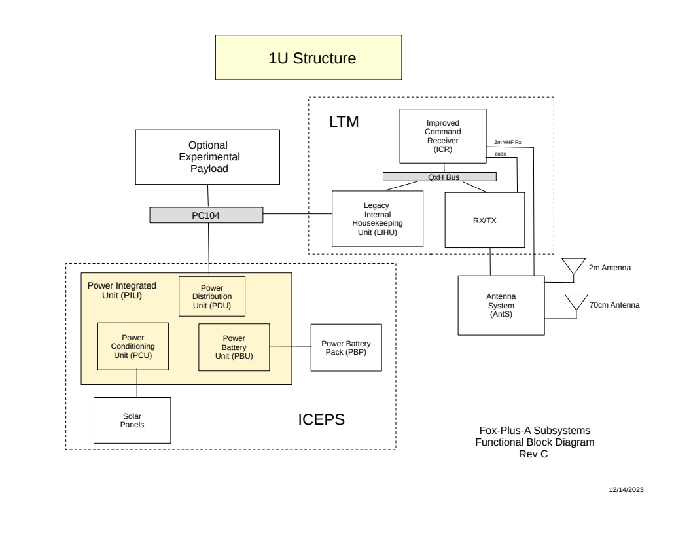
Fox-Plus Project Update
FOX+
Fox-Plus System Overview
4

Slide 4
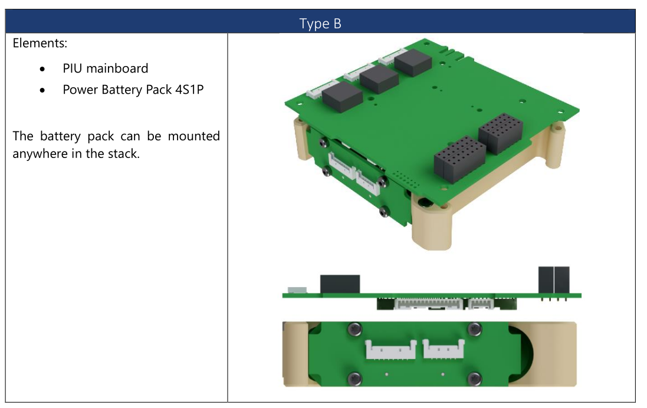
Fox-Plus Project Update
FOX+
ISISPACE Compact Electrical Power System (ICEPS)
4

Slide 5
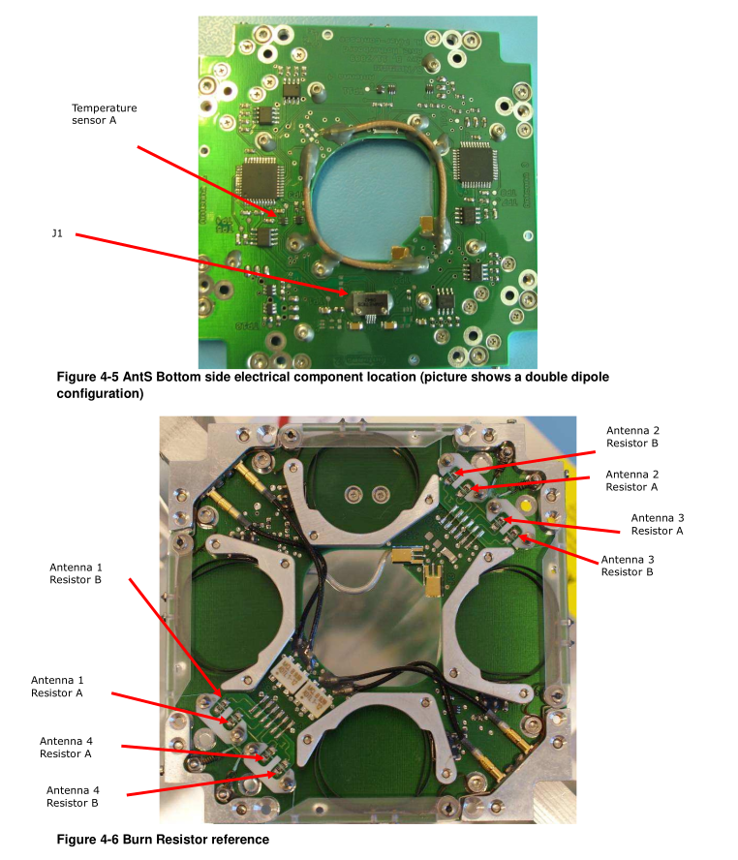
Fox-Plus Project Update
FOX+
ISISPACE Antenna System (AntS)
4

Slide 6
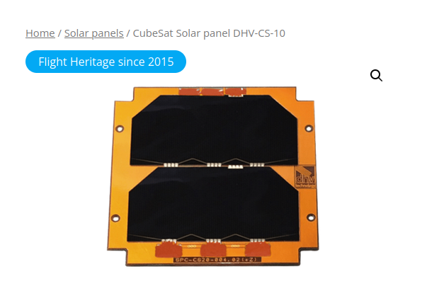
Fox-Plus Project Update
FOX+
ISISPACE 1U Solar Panel (X,Y Side example)
4

Slide 7
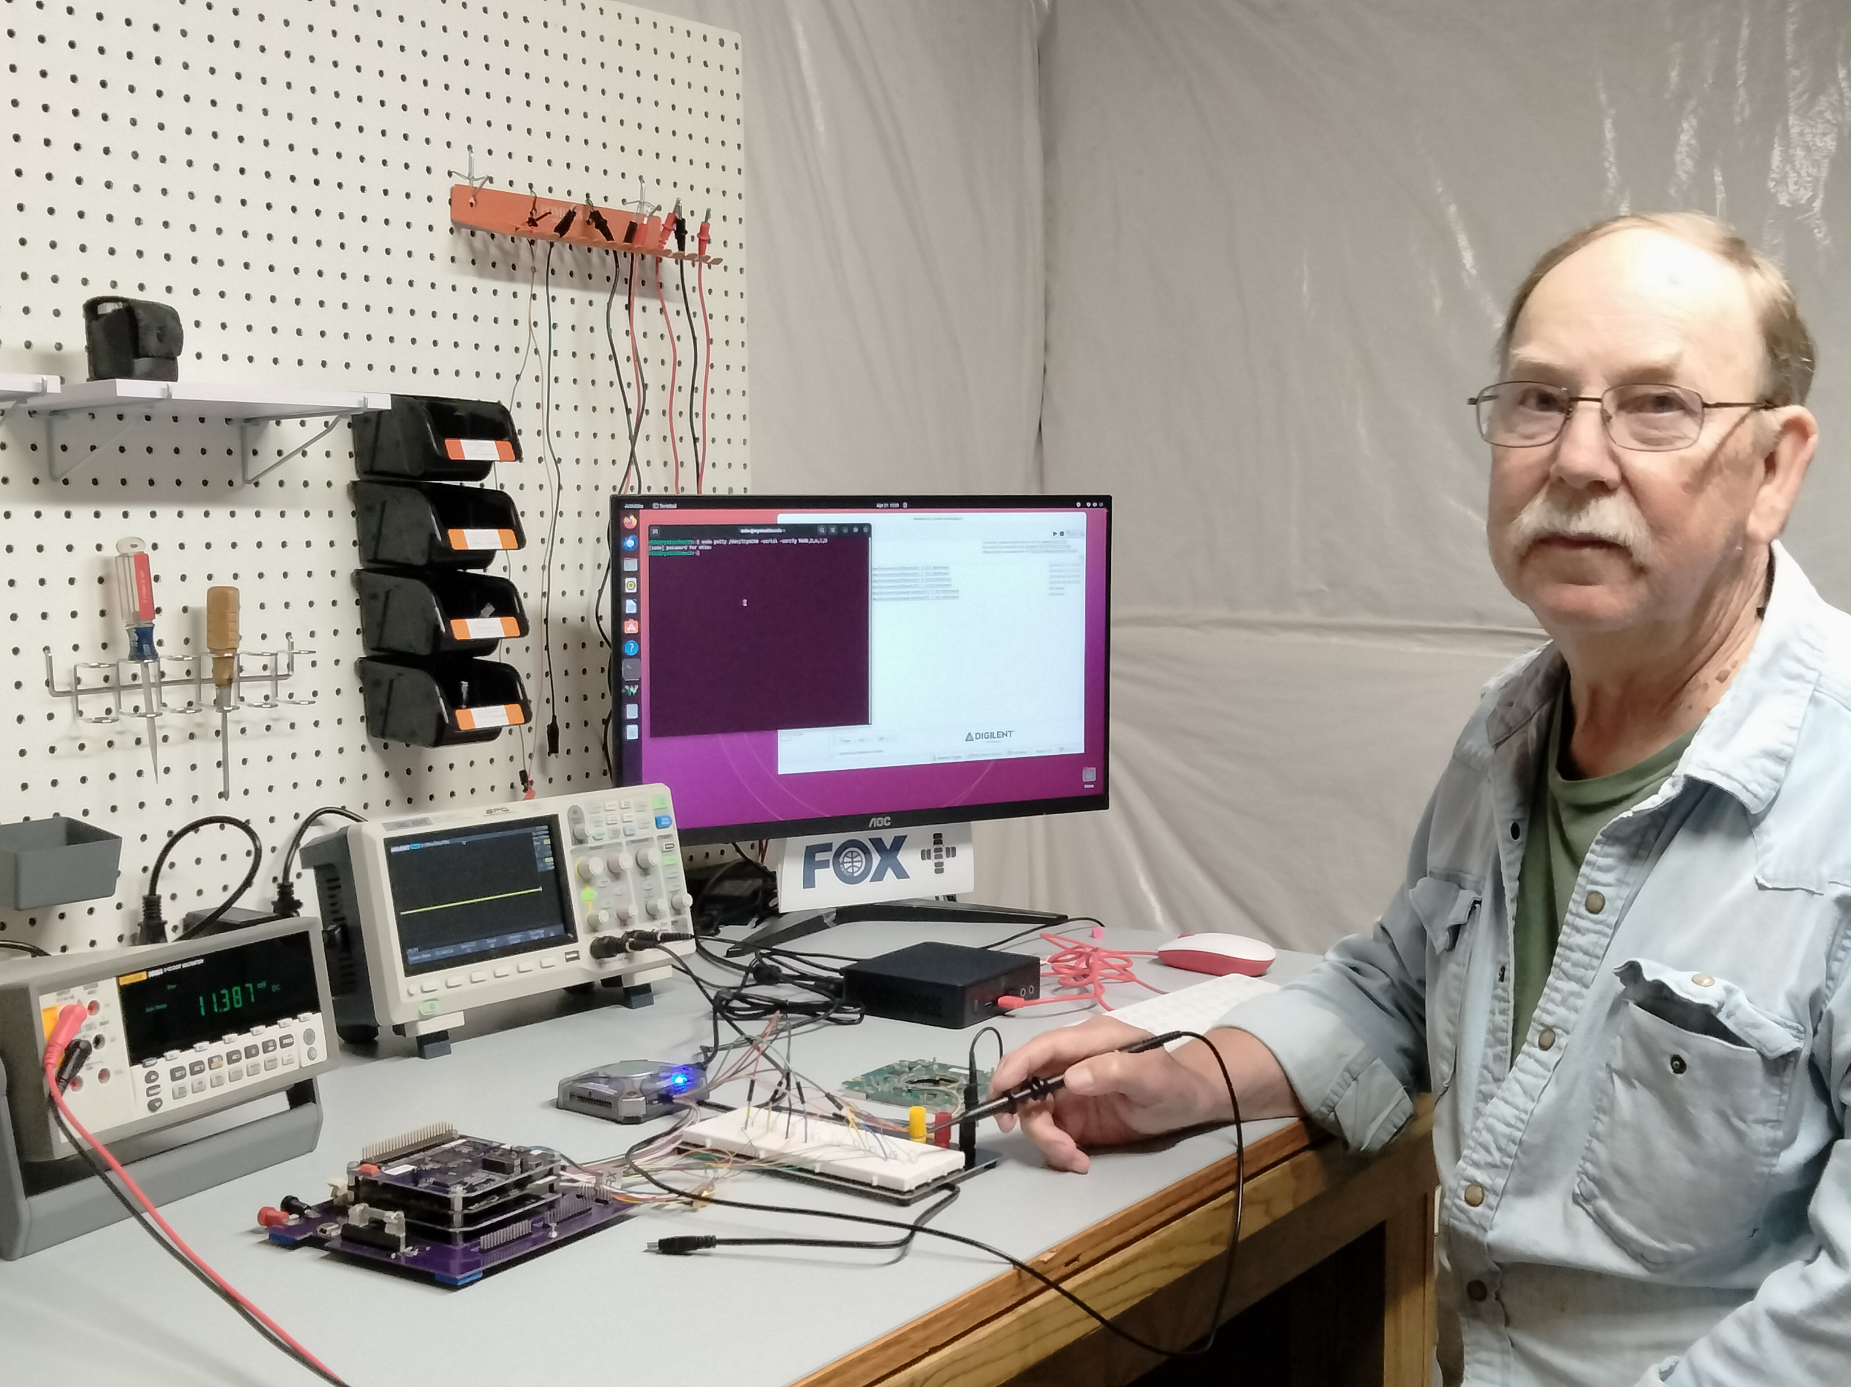
Fox-Plus Project Update
FOX+
TTest bench w/ LTM & AntS
4

Slide 8
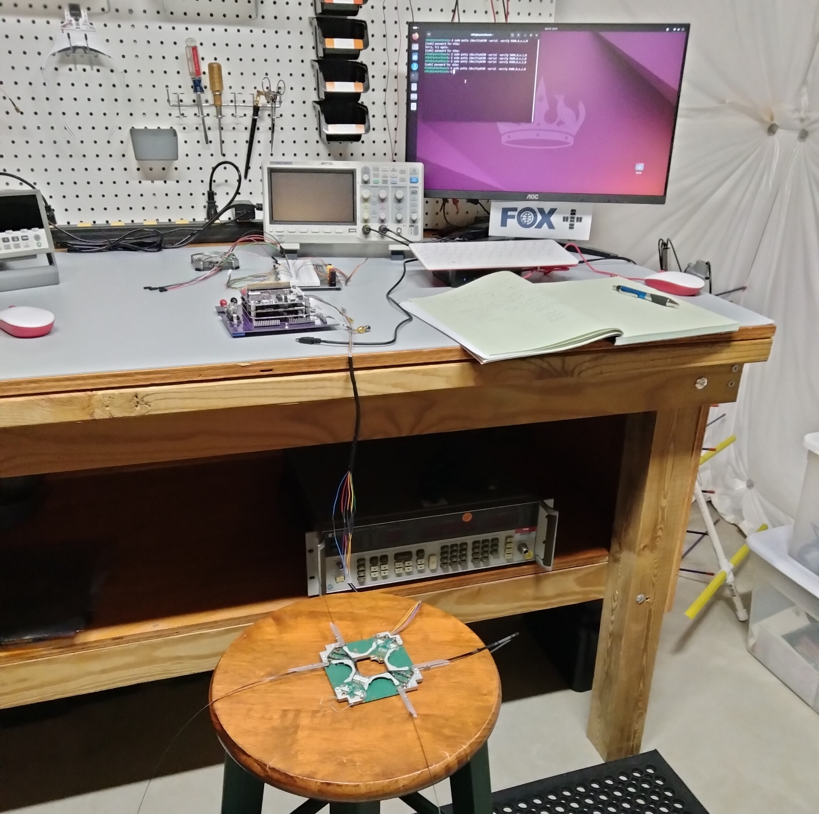
Fox-Plus Project Update
FOX+
Test: Antennas Deployed
4

Slide 9
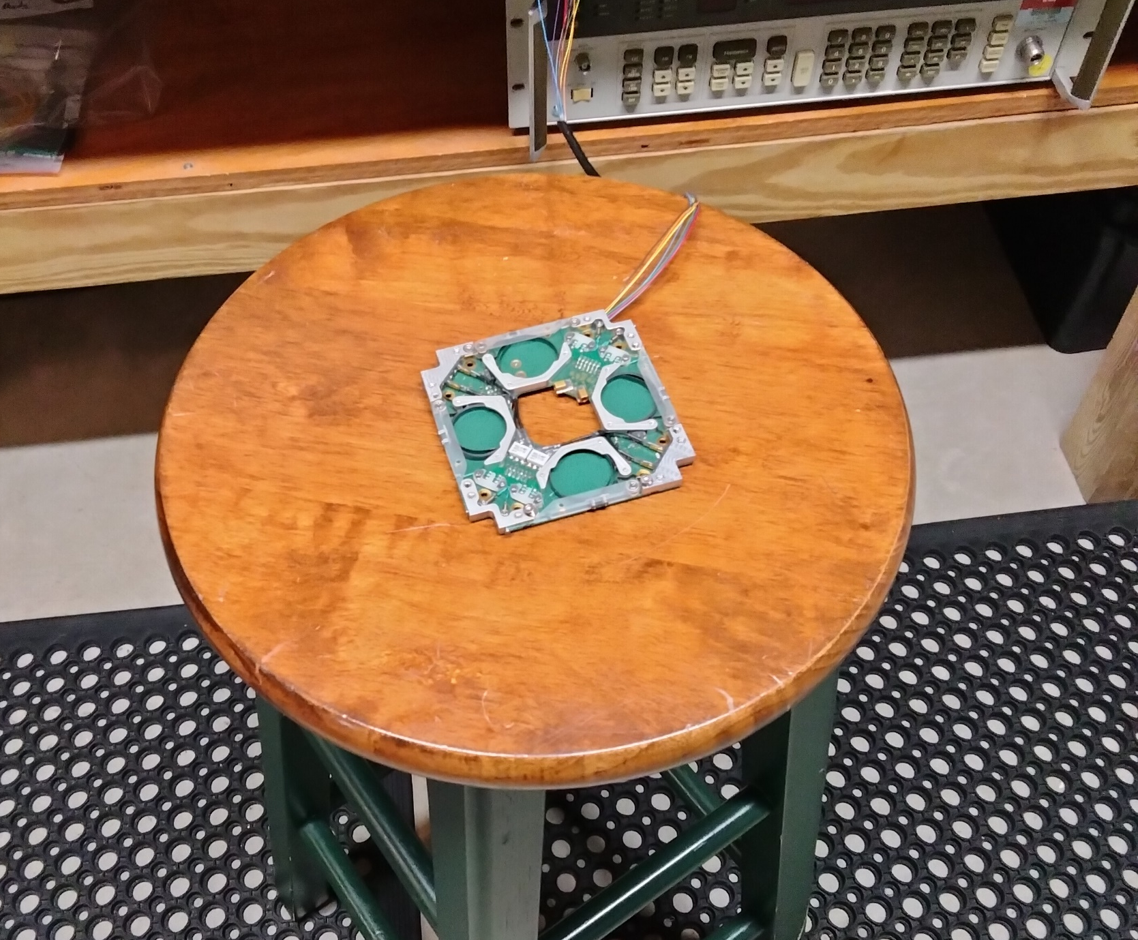
Fox-Plus Project Update
FOX+
Test: Antennas Stowed
4

Slide 10
Fox-Plus Project Update
FOX+
Software Status
(3) Software Apps or Entities:
Embedded SW (FIHU Flight SW) = HuskeySat for Testing
AMCOM = OTA Testing
FoxTelem = Ground Station SW
All require Fox+ revisions
4

Slide 11
Fox-Plus Project Update
FOX+
Okay – So where are we on Fox-Plus?
System Engineering Documentation: ICD in progress
Software – as shown in last slide
Structure – Solar Panels ship this week
- adaptor needed for ISISPACE EPS to FIHU
LTM Modules:
FIHU (LIHU v7) pcb complete, need to verify and populate
ICR – v2.1 being reworked, v2.2 in process of being built
RX/TX – in process of being built
4

Slide 12
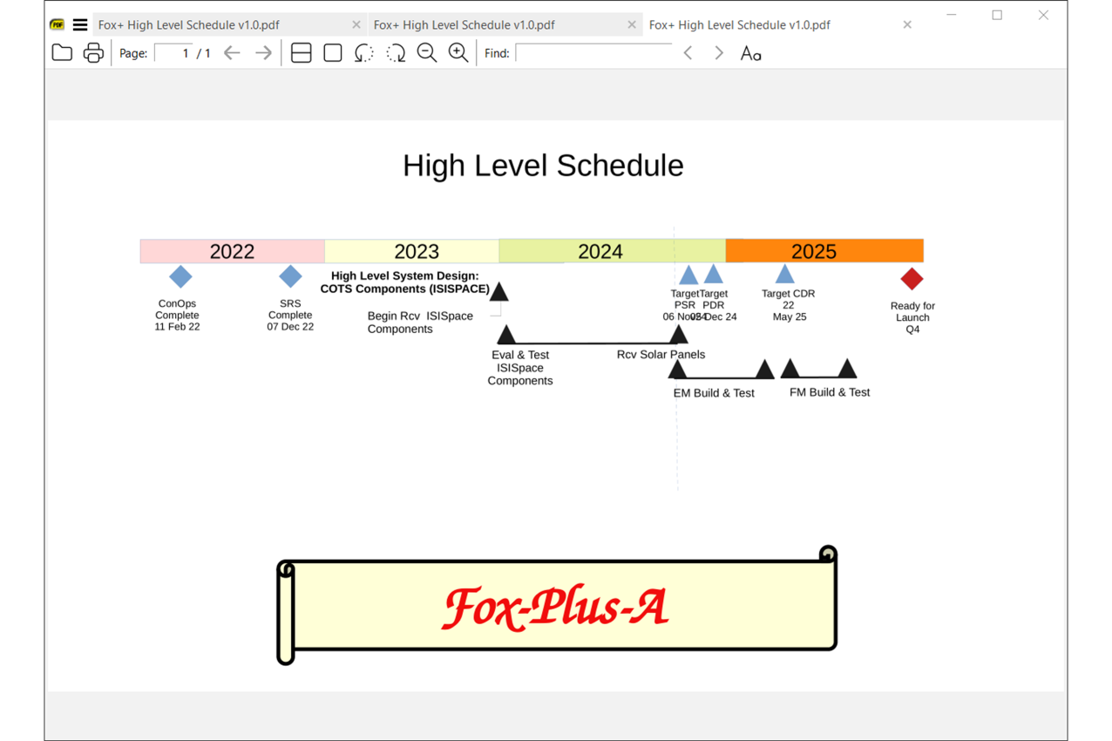
Fox-Plus Project Update
FOX+
4

Slide 13
Fox-Plus Project Update
FOX+
Next Milestones:
Project Status Review: Nov 6, 2024
Project Design Review: Dec 5, 2024 (target date)
Critical Design Review: May 25, 2025 (target date)
4

Slide 14
Fox-Plus Project Update
FOX+
Thanks to the Fox-Plus Engineering Volunteers!
Andrew Robinson, KA3WDW - Mechanical / Structural Engineer
Cliff Jenkins, KE8JAE - Software
Will Brozovic - Software
Leandra MacLennan, AF1R - EE, Hardware
Patrick Thomas, KB8DGC - System Engineer & PACSAT Liaison
4

Slide 15


Questions, comments, concerns?

